Slide 1

Information Hiding Using Cryptography And Steganography
Institute of Engineering
and Management
CSE - 4th Year
Group - 7

Slide 2
Introduction
Steganography is the art of hiding the fact that communication is taking place, by hiding information in other information.
Many different carrier file formats can be used, but digital images are the most popular because of their frequency on the Internet.
Encryption of information (text/file) using AES (Advanced Encryption Standard) algorithm.
Encryption of the used AES Encryption Key using RSA (Rivest - Shamir - Adleman) algorithm.
Embedding encrypted information and encrypted AES Encryption Key in a carrier image file using Steganography.

Slide 3
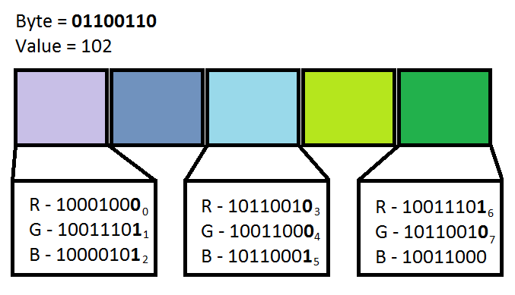
Image Steganography
LSB (Least Significant Bit) Replacement Method
A byte is embedded in three pixels.
Replace the LSBs of Red, Green and Blue values of the pixels.
Consecutive message bytes are embedded after a fixed number of pixels. This number is known as the stego-key.
Bytes of the message key are embedded in consecutive pixels at the beginning of the image.

Slide 4
Embedding Sequence :
RSA Encrypted Message Key (128-Byte)
RSA Encrypted Message Length (128-Byte)
AES-128 Encrypted Message Bytes
RSA Encrypted AES Encryption Key (128-Byte)
RSA Encrypted AES Initialization Vector (128-Byte)

Slide 5



A Demonstration…
+
Message File, 200KB
Carrier image
1024 X 768, 15KB
=
No Visible Difference
Steg Image
1024 X 768, 468KB

Slide 6

Tiyash Basu
Swarup Samanta
Prosenjit Dhali
Tarak Nath Mukherjee
Abhishek Saha

